Slide 1

Frontier Detection in Autonomous Drone Exploration Using a Hybrid of Frontier-Tracing and Ray-Casting Algorithms
Sugiarto Cokrowibowo
Rustan Tarakka
Andi Amijoyo Mochtar

Slide 2
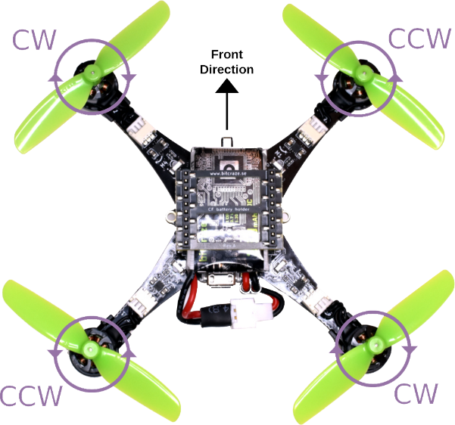
Unmanned Aerial Vehicles
Autonomous and Safety
Without onboard pilot
useful for autonomous operations in environments that pose risks to human safety
operates without an onboard pilot
MAV
Swarm Operation
Compact, agile, and safety
To increase their capability they can work in parallel and collaborative team

Slide 3
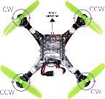
Autonomous Exploration
Frontier-Based Exploration
Brian Yamauchi 1997,1998
Frontiers Detection
Frontier-Tracing Frontier Detection
Phillip Quin 2021
Frontier detection is a critical element of exploration algorithms, where improvements in its efficiency directly accelerate the exploration process.
Ray-Casting Algorithm
drone equipped with four ranging sensors oriented forward, backward, left, and right

Slide 4

Related Work
01
Naïve Method
The most basic approach
02
Wavefront Frontier Detector (WFD)
WFD
03
Fast Frontier Detection (FFD)
FFD
Frontier-Based Exploration
04
WFD-INC
WFD-INC
Frontier Detection.
05
WFD-IP
WFD-IP
06
Naïve Active Area (NaïveAA)
NAÏVE AA
07
Expanding-Wavefront Frontier Detection (EWFD)
EWFD
Frontier-Tracing Frontier Detection (FTFD)
08
FTFD

Slide 5
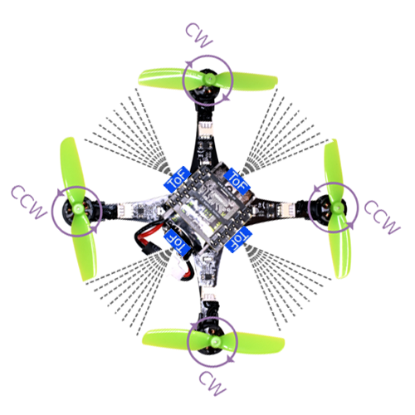
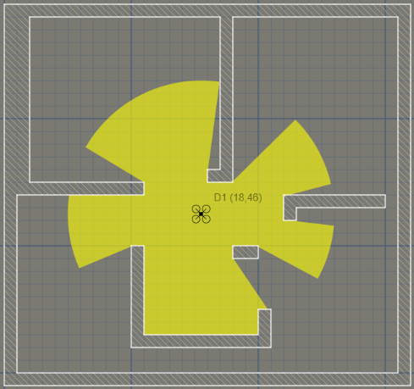
Hybrid of Frontier-Tracing and Ray-Casting Algorithm
Frontier-Tracing Frontier Detection
The Frontier-Tracing Frontier Detection (FTFD) algorithm exploits the fact that the perimeter of a new sensor observation is highly likely to intersect with previously identified frontiers.
Ray-Casting Algorithm
Frontier detection is performed through a ray-casting algorithm that utilizes distance measurements from four ranging sensors positioned in the forward, backward, left, and right orientations.

Slide 6
Algorithm
Algorithm DetectFrontiers(droneIndex, ci, cj)
Input: droneIndex, current cell (ci, cj)
Output: Updated frontier set frontiers[droneIndex]
1: Initialize parameters: rays = 360, step = 0.01, MAX_RADIUS = sensorFoV * cellSize + cellSize
2: For each ray direction i from 0 to 360 with step 2:
3: Compute ray direction (dx, dy) from angle i
4: Start ray from the center of cell (ci, cj)
5: While ray length < MAX_RADIUS:
6: Move ray forward by step
7: Convert ray position to grid cell (row, col)
8: If cell is outside map OR is obstacle/wall:
9: If cell is valid and marked unknown:
10: Mark (row, col) as frontier and update frontier
11: Stop tracing this ray
12: End While
13: End For
14: Return frontiers[droneIndex]

Slide 7
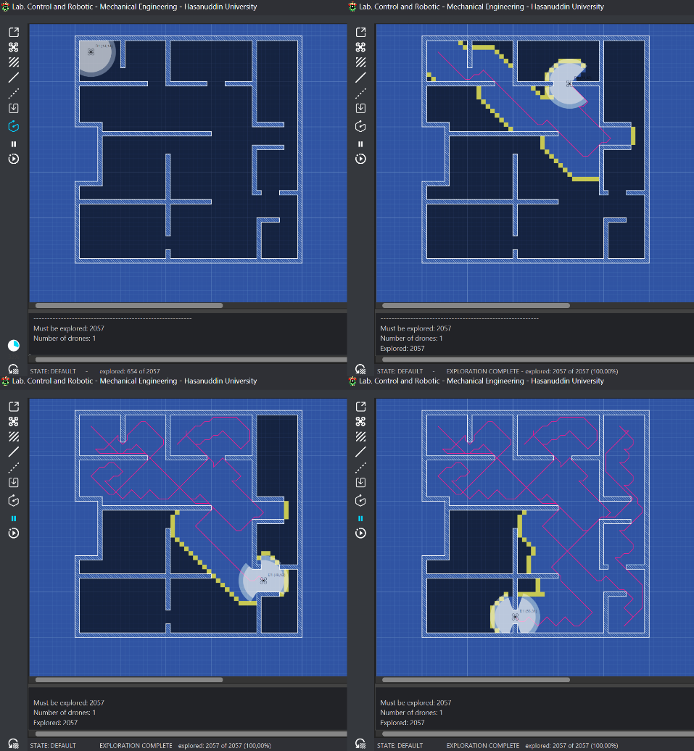
Result ---
Hybrid of Frontier-Tracing and Ray-Casting Algorithms
The final result of the exploration in Frontier Detection in Autonomous Drone Exploration Using a Hybrid of Frontier-Tracing and Ray-Casting Algorithms, implemented using the JavaFX framework, demonstrates that all 2057 cells in the environment designated for exploration were successfully explored

Slide 8
Infographic Data Visualization
Conclusion
Simulation results demonstrated that the proposed hybrid approach successfully achieved complete exploration of the grid-based environment, validating its effectiveness for autonomous drone exploration tasks.
For future research, we intend to extend the proposed frontier-based exploration algorithm to a swarm of drones, enabling cooperative exploration in larger and more complex environments. To facilitate decentralized coordination among the swarm, we plan to adopt a stigmergy-based mechanism

Slide 9
Thank you
Notes:
https://unsplash.com/photos/bJjsKbToY34

